Slide 1

Introduction about Ansible
Ansible is a radically simple IT automation platform that makes your applications and systems easier to deploy.
It support configuration management with examples as below.
    Configuration of servers
    Application deployment
    Continuous testing of already install application
    Provisioning
    Automation of tasks
1

Slide 2

What is Ansible?
Ansible is an opensource configuration management and orchestration utility (planning or coordination of the elements of a situation to produce a desired effect).
It can automate and standardize the configuration of remote hosts and virtual machines. Its orchestration functionality allows Ansible to coordinate the launch and graceful shutdown of multitiered applications. Because of this, Ansible can perform rolling updates of multiple systems in a way that results in zero downtime.
Instead of writing custom, individualized scripts, system administrators create high-level plays in Ansible. A play performs a series of tasks on the host, or group of hosts, specified in the play. A file that contains one or more plays is called a playbook.

Slide 3

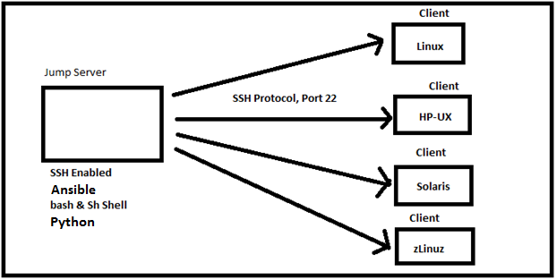


Slide 4
Introduction
Ansible Tower is Ansible at a more enterprise level. It is a web-based solution for managing your organization with a very easy user interface that provides a dashboard with all of the state summaries of all the hosts, allows quick deployments, and monitors all configurations.
The tower allows you to share the SSH credentials without exposing them, logs all the jobs, manage inventories graphically and syncs them with a wide variety of cloud providers.
Tower can keep a history of the times that job has run, the successes/failures, logs, what servers you have run it against, and the status of those servers. Because it stores all this information, it makes auditing a breeze.
In my opinion, the benefits to using Ansible Tower are: simplifying the use of Ansible, auditing, and security.

Slide 5
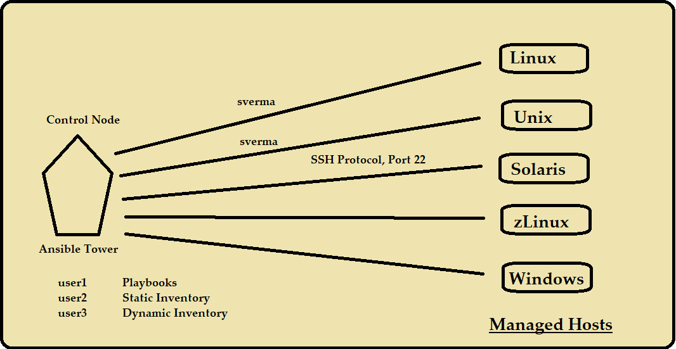

Slide 6
RBAC: ROLE-BASED ACCESS CONTROL
Let’s say I have 6 playbook, and I want to provide
Playbook 1 and 2 >> only access to user 1
Playbook 3 and 4 >> only to user 2
All these things we can achieve by ansible tower.

Slide 7
ANSIBLE VS ANSIBLE TOWER
Suppose, I have a playbook configured with sverma user, and now user umesh want to run the playbook, so umesh mush be knowing password for sverma, that’s security breach in ansible, but
We can avoid it in ansible tower.
Ansible tower is written in Django, and it used postgress sql database. It provide communication between different component by rabbit MQ.

Slide 8
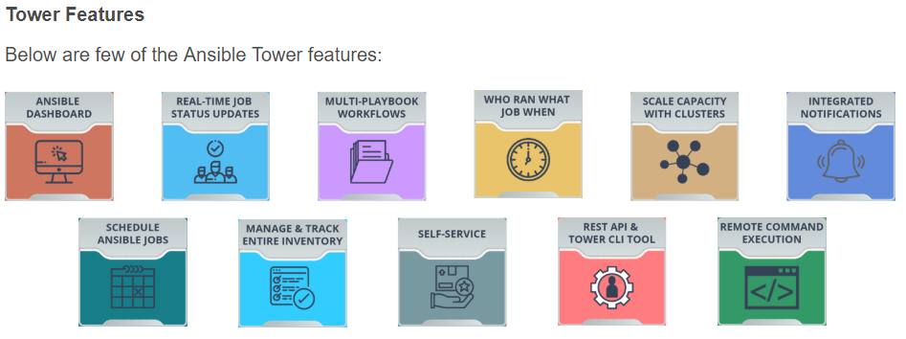
Introduction
Some of the important features of Ansible Tower are listed below.

Slide 9
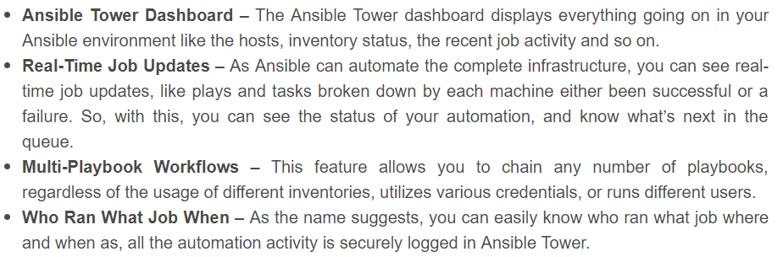
Introduction
Some of the important features of Ansible Tower are listed below.

Slide 10
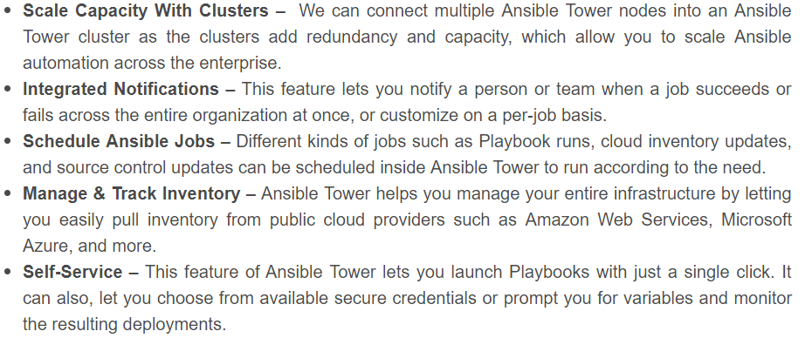
Introduction
Some of the important features of Ansible Tower are listed below.

Slide 11
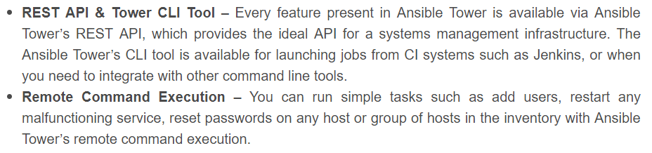
Introduction
Some of the important features of Ansible Tower are listed below.

Slide 12
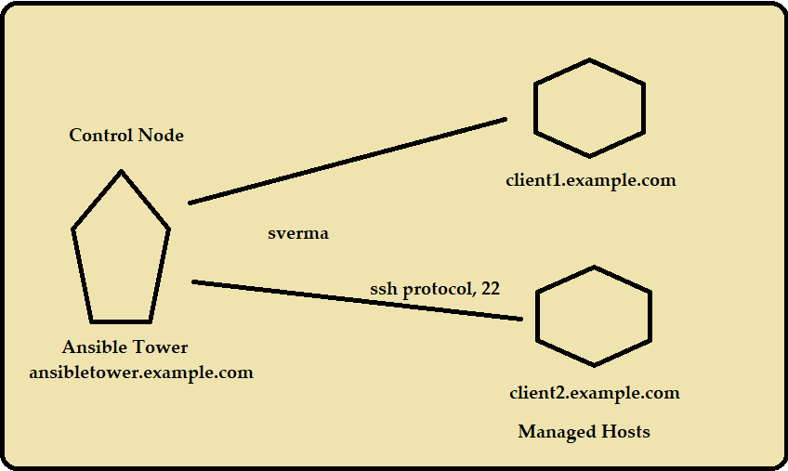

Slide 13
Note: Ansible Tower must be installed on RHEL 7, CentOS 7, or Ubuntu 16.04 LTS, and requires Ansible Core 2.6.X or later.
https://www.ansible.com/products/tower/trial
https://releases.ansible.com/ansible-tower/setup/
Download the latest software

Slide 14
ROLE-BASED ACCESS CONTROLS
Different people using an Ansible Tower installation need to have different levels of access. Some may simply need to run existing job templates against a preconfigured inventory of machines.
Others need to be able to modify particular inventories, job templates, and playbooks. Still others may need access to change anything in the Tower installation.
The Tower interface has a built-in administrative user, admin, that has superuser access to the entire Tower configuration.
The permissions Users have to make changes to Tower objects are managed through Role-Based Access Controls (RBAC). Users are assigned roles that grant permissions which define precisely who can see, change, or delete an object in Tower.

Slide 15
ORGANIZATIONS
An Ansible Tower Organization is a logical collection of Teams, Projects, and Inventories. Since all Users must be assigned to an Organization, a brief discussion of Organizations is necessary before looking at User configuration.

Slide 16
USER TYPES
By default, an admin User account is created by the Tower installer which has full control of the Tower installation.
Tower Users can be created as one of three user types.
System Administrator
System Auditor
Normal User

Slide 17
ORGANIZATION ROLES
Newly created Users inherit specific roles from their Organization, based on their user type.
Additional roles can be assigned to a User after it is created in order to grant permissions to view, use, or change additional Tower objects.
Admin
Auditor
Member
Read

Slide 19
Creating Machine Credentials for Access to Inventory Hosts
CREDENTIALS
Credentials are Ansible Tower objects that are used to authenticate to remote systems for various purposes. They may provide secrets such as passwords, SSH keys, or other supporting information needed to successfully access or use a remote resource.
Credential passwords and keys are encrypted before they are saved to the Tower database and can not be retrieved in clear text from the Tower user interface.
Users and Teams can be assigned privileges to use Credentials, but the secrets are not exposed to them.

Slide 20
Creating Machine Credentials for Access to Inventory Hosts
CREDENTIAL TYPES
Ansible Tower has a number of different types of Credentials that it can manage:
• Machine credentials are used to authenticate playbook logins and privilege escalation for
inventory hosts
Network credentials are used when Ansible network modules are used to manage networking equipment
Source Control (or SCM) credentials are used by Projects to clone and update Ansible project materials from a remote version control system such as Git, Subversion, or Mercurial
Inventory credentials are used to update dynamic inventory information from one of Ansible Tower's built-in dynamic inventory sources.

Slide 21
GitHub
To understand GitHub, you must first have an understanding of Git. Git is an open-source version control system that was started by Linus Trovalds—the same person who created Linux. Git is similar to other version control systems—Subversion, CVS, and Mercurial to name a few.
The “Hub” in GitHub
We’ve established that Git is a version control system, similar but better than the many alternatives available. So, what makes GitHub so special? Git is a command-line tool, but the center around which all things involving Git revolve is the hub—GitHub.com—where developers store their projects and network with like minded people.

Slide 22
DYNAMIC INVENTORIES
When Ansible runs a playbook, it uses an inventory to help determine against which hosts the plays should be run. Both Ansible and Ansible Tower make it easy to set up a static inventory of hosts which are explicitly specified in the inventory by the administrator.
However, these static lists require manual administration in order to keep them up to date. This can be inconvenient or challenging, especially when an organization wants to run the playbooks against hosts which are dynamically created in a virtualization or cloud computing environment.
In that scenario, it is useful to use a dynamic inventory. Dynamic inventories are scripts that, when run, dynamically determine which hosts and host groups should be in the inventory based on information from some external source.

Slide 23
DYNAMIC INVENTORIES
By default, Ansible Tower comes with built-in dynamic inventory support for a number of external inventory sources (or cloud inventory sources), including:
Amazon EC2
Google Compute Engine
Microsoft Azure Resource Manager
VMware vCenter
Red Hat Satellite 6
Red Hat CloudForms
OpenStack

